Slide 1


MULTI-FILTERED IMAGE APPROACH FOR DETECTION OF LUNG CANCER
MEDICAL APPLICATIONS
MMPP

Slide 2
PRESENTED BY
Prakash Raju Dept of ECE Panimalar Engineering College Chennai,India prakashmala2317@gmail.com | Murugesan Avudaiappan Dept of ECE Panimalar Engineering College Chennai,India dineshmurugesan69@gmail.com
Moorthy Shanmugam Dept of ECE Panimalar Engineering College Chennai,India moorthyshan01@gmail.com
WITH
Sajini Sathiaraj
Dept of ECE
Panimalar Engineering College Chennai,India ssajini6143@gmail.com
Prem Narayanan Srinivasan
Dept. of ECE
Panimalar Engineering College
Chennai,India
premsrini.115@gmail.com

Slide 3
ABSTRACT
This Project proposes a cancer detection method using MATLAB. Image pre-processing, feature extraction, and classification are the three steps of the suggested method. On a CT scan of a patient with lung cancer, the suggested approach was evaluated. The proposed method can be further extended to detect other types of cancers by training the machine learning models on appropriate datasets. In conclusion, the proposed method provides an efficient and accurate way of detecting cancer using medical images.

Slide 4
PANIMALAR
INTRODUCTION
Cancer is a term used to describe the disease that results from uncontrolled cellular growth and division. While some types of cancer cause rapid cell growth, others cause cells to grow and divide more slowly. Over 8.8 lakh people in India die each year from smoking cigarettes. According to 2021 report. Smoking is a major risk factor for cancer. Alcohol consumption can lead to physical inactivity, excess body weight and poor nutrition. Certain forms of cancer, such as leukemia, do not result in visible growths, while others can cause tumors. Various imaging techniques have been developed to detect cancer, including angiogenesis imaging, hypoxia imaging, apoptosis imaging, and endocrine tumor imaging.

Slide 5
LITERATURE SURVEY
S. S. Lokhande et.al [1] it offers the most accurate way to identified the image's primary edge and also prevents oversegmentation. When compared to the thresholding algorithm, it provides 100% accuracy. As a result, segmentation is effective. When compared to other procedures, the outcomes from the suggested technique are quite encouraging.
K.Punithavathy et.al [2] texture analysis and FCM were used to construct an automatic lung cancer diagnosis system for PET/CT images. Pre-processing methods improve the cancer detection's precision. The search space is shrunk and accurate lung ROI extraction is made possible by morphological operations. The outcomes of our methodology show that a number of important texture features were obtained from the texture analysis. These features that are used as the FCM classifier's input aid in the precise diagnosis of lung cancer. The proposed methodology's results are encouraging, with a 92.67% total accuracy

Slide 6
LITERATURE SURVEY
Bhagyarekha U. Dhaware et.al [3] used a input to evaluate the normality or abnormality of CT lung pictures. The procedure that has been used has been found to be helpful and it produces results that are more accurate and reliable than those indicated in the literature. Using 12 dissimilar statistical features, contrast, correlation, and variance, excellent accuracy has been achieved. Six separate and highly effective features are employed to invert various
moments, cluster prominence, and cluster shade in order to increase accuracy and extract all 12 features.
Sayali Satish Kanitkar et.al [4] the contacting items in the image are separated using the suggested marker-controlled watershed segmentation technique. It offers the most accurate way to identify the image's primary edge and also prevents over segmentation. When compared to the thresholding algorithm, it provides 100% accuracy. As a result, segmentation is effective. When compared to other procedures, the outcomes from the suggested technique are quite encouraging

Slide 7
LITERATURE SURVEY
Bin Wu et.al [5] proposed the median filter and Wiener filter were used in the preprocessing of the CT images to get rid of noise. Second, using the Otsu thresholding approach, the preprocessed images were turned into binary images. Thirdly, body regions were recovered from the binary pictures, and GLCM was used to determine body region features (contrast, correlation, energy, and homogeneity). Finally, lung cancer detection models were created using features, BPNN, and SVM. It was concluded from the results that the model based on SVM was a promising tool for the recognition of lung cancer in its early stages, proving the theory presented above

Slide 8
PROPOSED WORK
Image Segmentation: Matlab provides several tools for image segmentation, including thresholding, region growing, watershed segmentation, and active contours. Matlab provides several built-in functions for image segmentation, such as the "regionprops" function, which can be used to extract properties of the different regions in an image.Image processing refers to the manipulation of an image to enhance its quality or extract useful information. Matlab offers a variety of image processing functions, such as "imread" for reading an image file, "imresize" for resizing an image, and "imfilter" for filtering an image. Feature extraction: The technique of extracting important data or characteristics from a picture for additional analysis is known as feature extraction. For extracting properties like texture, colour, form, and edges, Matlab offers routines. Image analysis and visualization: Matlab provides functions for analyzing and visualizing image data, such as histograms, scatterplots, and 3D surface plots.

Slide 9
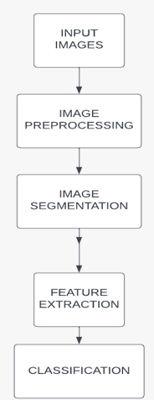
METHODOLOGY
The methods we used here are Image enhancement , Histogram equalization, Contrast stretching, Filtering Techniques, Image Segmentation, Thresholding , Region growing, Watershed Segmentation, Image feature extraction, Edge detection, Corner detection.
Image recognition and classification: Matlab provides functions for recognizing and classifying images based on their features or properties. It is increasingly popular in various medical fields, as they can help detect diseases earlier and improve treatment outcomes. Early detection is critical in ensuring timely and effective treatment for patients. Therefore, using image processing to improve the quality of medical images can be essential in improving outcomes. It is important to ensure that any use of these techniques is done. ethically.

Slide 10
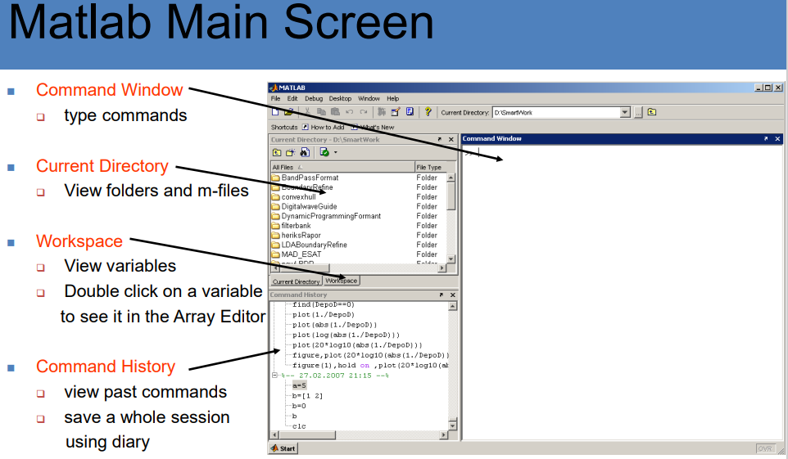
WORKING AND STRUCTURE OF MATLAB
Working of CST Software

Slide 11
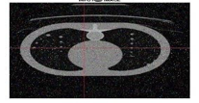
INPUT CT SCAN

Slide 12
DISCUSSION
SUPER IMPOSED ORIGINAL IMAGE
Grayscale images are commonly used in image processing using MATLAB because they are simpler to process than colour images. Grayscale images have only one channel of information, which is the intensity or brightness of each pixel, while colour images have three channels representing the red, green, and blue colour components of each pixel. Grayscale images can be enhanced using various techniques such as contrast stretching, histogram equalization, and filtering.
GRADMAG The gradient magnitude image is a useful tool for edge detection in image processing. In MATLAB, you can use the built-in function imgradient to calculate the gradient magnitude image of an input image.

Slide 13
DISCUSSION
REGIONAL MAXIMA:
Regional maxima are local maxima in an image that are higher than all the neighboring pixels. The regional maxima can be used in various image processing applications, including image segmentation, feature extraction, and object recognition. In MATLAB, the regional maxima can be identified using the imregionalmax function.
WATER SHED TRANSFORM:
The watershed concept is a well-established concept in topography, and its application in image processing involves the use of watershed segmentation. This segmentation method identifies the dividing line with the least value, which corresponds to the rapid change in boundary. By treating the image as a plane with light pixels being high and dark pixels being low, the watershed transform can locate catchment basins and watershed edge lines in the image. However, one significant drawback of this method is that it often leads to over- segmentation. To address this issue, morphological operations such as opening by reconstruction and closing by reconstruction are performed on the watershed segmented image to obtain a final segmented image.

Slide 14
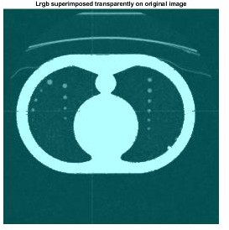
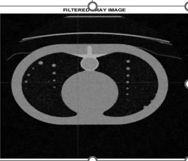
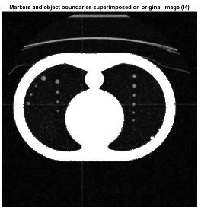

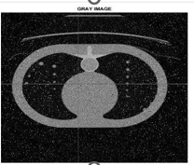
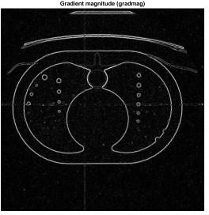
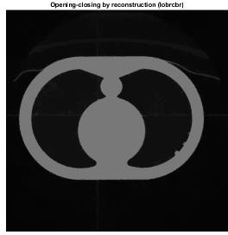
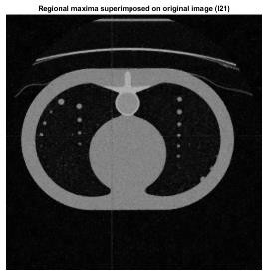
RESULTS

Slide 15
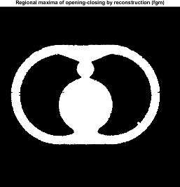
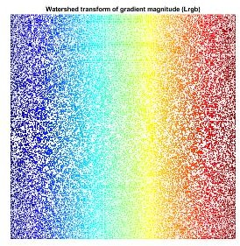
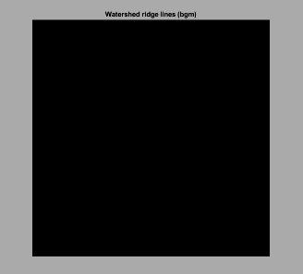
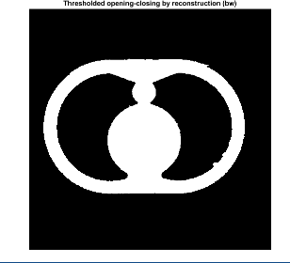
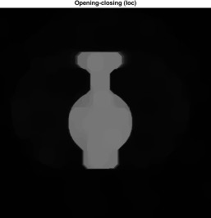
RESULTS

Slide 16
CONCLUSION
Preventing lung cancer using medical imaging involves early detection through screening, which enables prompt treatment and better patient outcomes. In conclusion, this study presents a lung cancer detection approach utilizing MATLAB, which involves image pre-processing, feature extraction, and classification techniques. The proposed method has been evaluated on CT images of lung cancer patients and has demonstrated high efficiency and accuracy. Furthermore, by training the machine learning models on relevant datasets, the proposed method can be expanded to detect other types of cancers. Therefore, this research provides a promising solution for lung cancer detection through medical imaging with significant potential for future clinical applications.

Slide 17
REFERENCES
[1]Anita chaudhary, SonitSukhraj Singh “Lung Cancer Detection on CT Images by Using Image Processing”2012 International Conference on Computing Sciences Final Watershed Segementation [2]Nihad Mesanovic, Haris Huseinagic, Matija Males, , Mislav Grgic, Emir Skejic, Muamer Smajlovic ”Automatic CT Image Segmentation of the Lungs with Region Growing Algorithm” [3] Sayani Nandy, Nikita Pandey “ A Novel Approach of Cancerous Cells Detection from Lungs CT Scan Images’’ International Journal of Advanced Research in Computer Science and Software Engineering Volume 2, Issue 8, August 2012 [4]Prof. Samir Kumar Bandyopadhyay “Edge Detection From Ct Images Of Lung’’ International Journal Of Engineering Science & Advanced Technology Volume - 2, Issue - 1, 34 – 37 [5]FatmTaher, NaoufelWerghi and Hussain Al- Ahmad “Extraction of Sputum Cells using Thresholding Techniques for Lung Cancer Detection” 2012 International Conference on Innovations in Information Technology [6]AjmedS.Al-Fehoum, Eslam B.Jaber, Mohammed A.Al-Jarrah “Automated detection of lung cancer using statistical and morphological image processing techniques,” Journal of Biomedical Graphics and Computing, 4(2), pp. 33 - 42, 2014. [4] [7]Gang Xie, Tianrui Cao, Chengdong Yan, “Texture Features Extraction of Chest HRCT Images based on Granualr Computing,” Journal of Multimedia, 5(6), pp. 639 – 647, 2010.

Slide 18
REFERENCES
[4] [8]Qi Song, Junjie Bai, Dongfeng Han, Sudershan Bhatia, Wenqing Sun, William Rockey, John E. Bayouth, John M.Buatti and Xiaodong Wu, “Optimal Co-Segmentation of Tumor in PET-CT Images with Context Information,” IEEE Transactions on Medical Imaging, 32(9), pp. 1685 – 1697, 2013. [5] [9]C. Panyindee and W. Chiracharit, “ Detection of Lung Tumors in Chest PET/CT Images by using Watershed Transform and Image Mapping,” The 3rd International Symposium on Biomedical Engineering (ISBME 2008), pp. 9 – 12, 2008. [10]\K.A.G.Udeshani, R.G.N. Meegama, T.G.I.Fernando, “Statistical Feature - based Neural Network Approach for the Detection of Lung Cancer in Chest X-Ray Images,” International Journal of Image Processing (IJIP), 5(4), pp. 425 – 434, 2011. [11]G.S. Cox, F.J. Hoare, G.de Jager, “Experiments in Lung cancer nodule detection using texture analysis and neural network classifiers,” Third South African Workshop on Pattern Recognition, Pretoria 1992. [12]M.S. Ahmad, M. Shahid Naweed and M. Nisha “Application of Texture Analysis in the Assessment of Chest Radiographs,” International Journal of Video & Image Processing and Network Security IJVIPNS-IJENS, 9(9), pp. 32 – 36, 2009. [13]Balaji Ganeshan, Sandra Abaleke, Rupert C.D. Young, Christopher R Chatwin and Kenneth A. Miles, “Texture analysis of non-small cell lung cancer on unenhanced computed tomography: initial evidence for a relationship with tumour glucose metabolism and stage,” Cancer Imaging, 10(1), pp. 137-143, 2010

Slide 19
REFERENCES
[14]Ada, Rajneet Kaur, “Early Detection and Prediction of Lung Cancer Survival using Neural Network Classifier,” International Journal of Application or Innovation in Engineering & Management, 2(6), pp. 375 – 383, 2013. [15]Mir Rayat Imtiaz Hossain, Imran Ahmed, Md. Hasanul Kabir, “Automatic Lung Cancer Detection using GLCM features,” Asian Conference on Computer Vision ACCV’14, Singapore, 2014. [16]Guo Xiuhua, Sun Tao, Wu Haifeng, He Wen, Liang Zhigang, Zhang Mengxia, GuoAimin, Wang Wei, “Support Vector Machine Prediction Model of Early – stage Lung Cancer Based on Curvelet Transform to Extract Texture Features of CT Image,” World Academy of Science, Engineering and Technology, 4(11), pp. 278 – 282, 2010. [17]Sandeep A. Dwivedi, R.P. Borse, Anil M.Yametkar, “ Lung Cancer detection and Classification by using Machine Learning & Multinomial Bayesian,” IOSR Journal of Electronics and Communication Engineering (IOSR – JECE), 9(1), pp. 69 – 75, 2014. [18]Vinod Kumar, Kanwal Garg, Vijay Kher, “Early Diagnosis of Lung Cancer with ANN, FCM and FMNN,” International Journal of Advanced Research in Computer Science and Software Engineering, 3(12), pp. 378 – 383, 2013.

Slide 20
PUBLICATIONS
S.NO | AUTHOR NAME | CONFERENCE NAME | PAPER TITLE | STATUS | INDEX
1 | Sajini.S Murugesan.A Prem.S Prakash.R Moorthy.S | IEEE Conference will be held on 28th April 2023 at Panimalar Engineering College. | MULTI-FILTERED IMAGE APPROACH FOR DETECTION OF LUNG CANCER | Submitted for Conference | IEEE

Slide 21
THANK YOU

